Slide 1
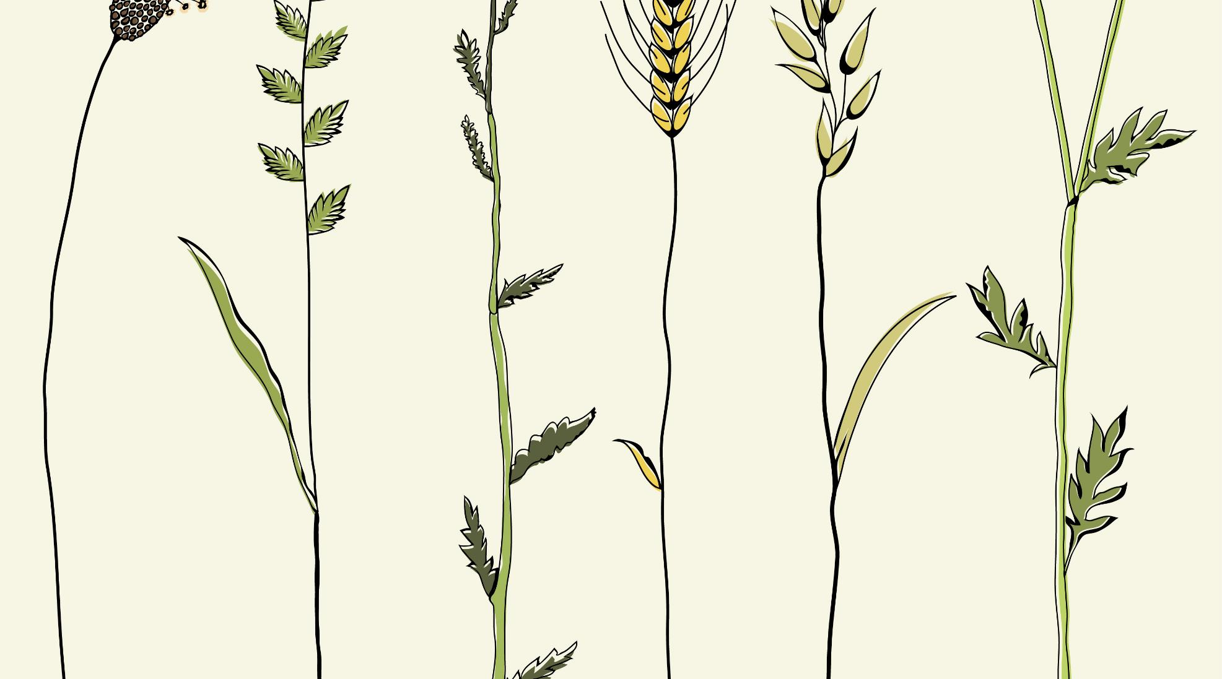
Precision Agriculture – Coimbatore based crop suggestion system using ML and IoT
TEAM 9
Gayathri B – 18Z218
Poovizhi Mangai S K – 18Z236
Praja S S – 18Z237
Shivathmica C – 18Z249
Sneha Sridharan – 18Z252
Guide Name: Dr. N. Gopika Rani
Company Name: Niagara Automations, Coimbatore

Slide 2
PROBLEM STATEMENT
Farmers are not aware of the right crop according to their soil characteristics and site specific parameters. Due to this the yield can be low and they face a setback in productivity.
A system to recommend the most appropriate crop to farmers using machine learning models such as Random forest, KNN and Decision tree which are combined to form an ensemble model. It is based on certain input parameters like soil pH, EC (Electrical Conductivity), N, P, K, soil type, soil moisture, area and environmental conditions like temperature and rainfall will help significantly increase productivity and reduce loss. The trained model is further given real time inputs from the IoT system along with user inputs to give the output.

Slide 3
EXISTING SYSTEM
METHODOLOGY USED
One existing system used majority voting technique with learners such as Random forest, Decision tree and Naïve Bayes.
Another existing system used ANN
DRAWBACKS
Absence of sensors for input making it essential for users to type all the inputs.

Slide 4
OUR PROPOSED SYSTEM
METHODOLOGY
Ensemble model with majority voting technique, using a combination of algorithm namely Random Forest, kNN, and Decision Tree.
Arduino Uno embedded with Temperature sensor, pH sensor, Soil Moisture sensor and Humidity sensor to input accurate values of the above parameters to the system.
ADVANTAGES
Designed exclusively for areas in and around Coimbatore.
All necessary soil parameters are taken into consideration.
Ensemble model gives more prediction and efficiency than any of the models could achieve alone.
Since IoT is implemented to collect input data, the recommendation system is very precise and suitable.

Slide 5
SYSTEM DESIGN
Sensor Data (IoT)
User Input (Location, Soil type)
Environment Data
Random Forest
Decision Tree
KNN
Trained Model
Recommended crop
Data Pre-processing like treating missing values and outliers
Feature Scaling
Ensemble Model
Soil Characteristics

Slide 6
Arduino Uno R3 and Sensors
ESP8266 Wi-Fi Module
Input to the trained system
Server

Slide 7
HARDWARE AND SOFTWARE REQUIREMENTS
HARDWARE REQUIREMENTS:
IoT:
Arduino Uno R3
Temperature Sensor
Soil Moisture Sensor
Soil pH Sensor
ESP8266 Wi-Fi Module
Operating Systems: Windows 8 or above
Memory: Minimum 4 GB RAM
SOFTWARE REQUIREMENTS:
Arduino IDE 1.8.0
Python
Jupyter Notebook

Slide 8
IMPLEMENTATION

Slide 9
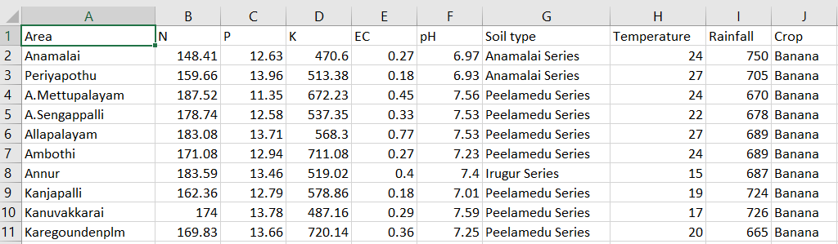
DATA SET

Slide 10
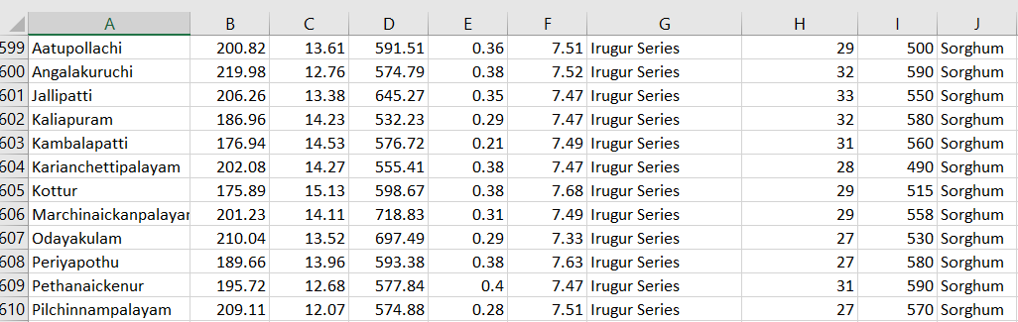

Slide 11
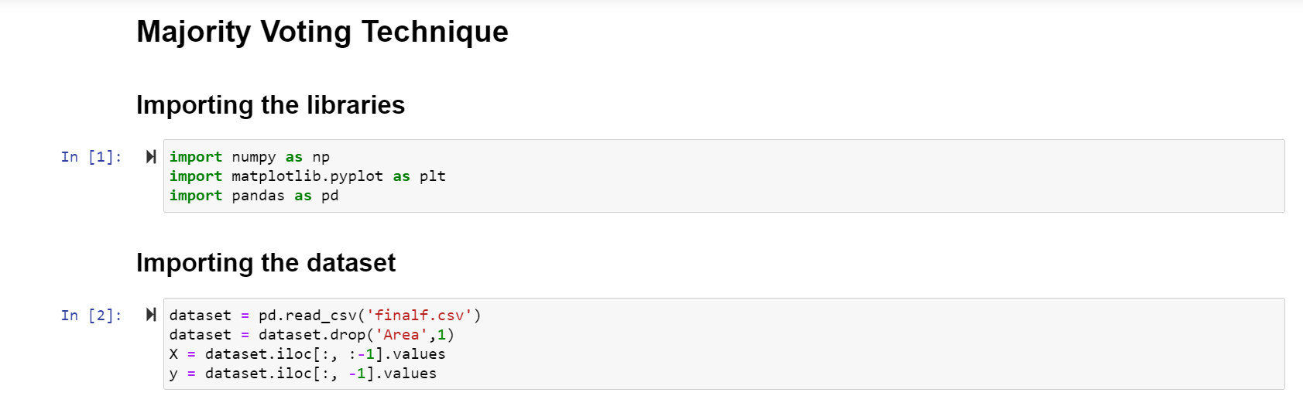
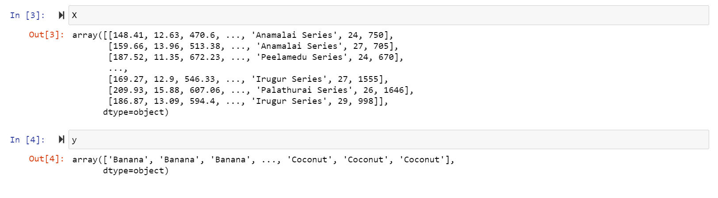

Slide 12
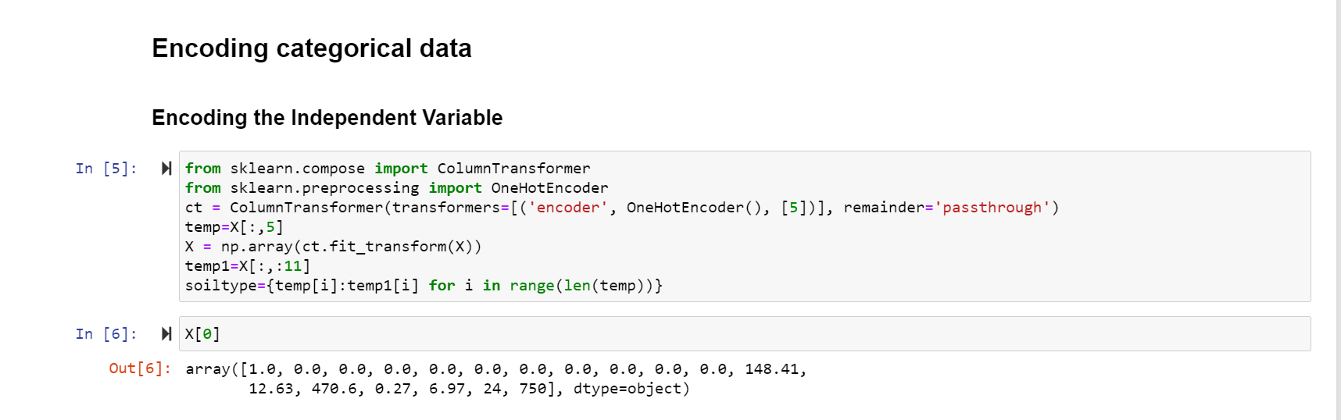
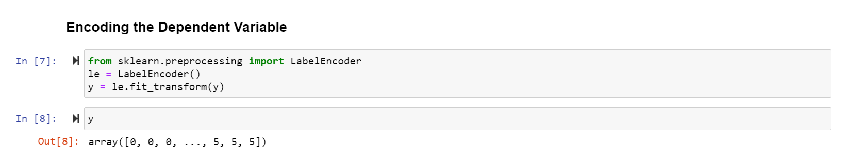

Slide 13
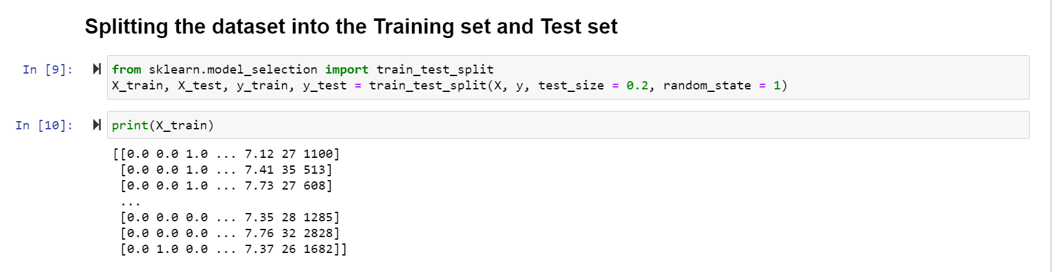
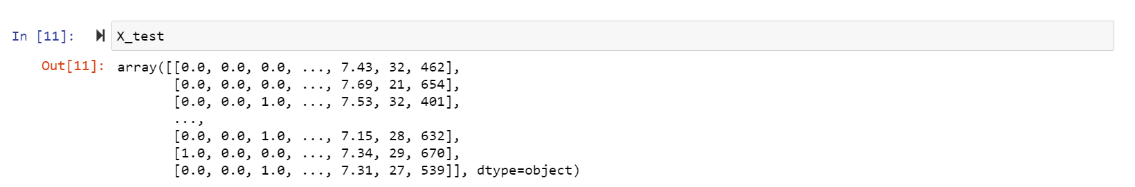

Slide 14
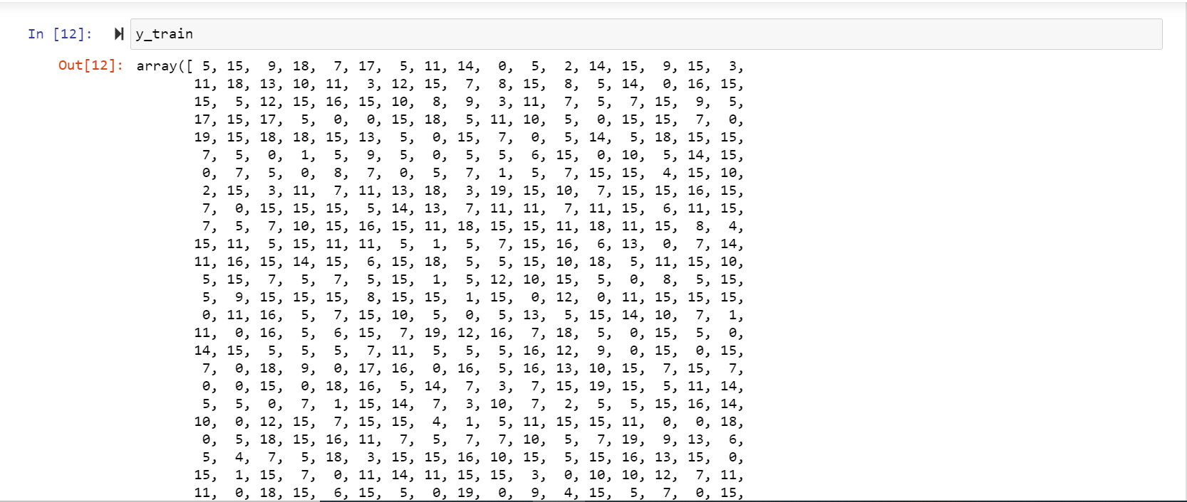

Slide 15
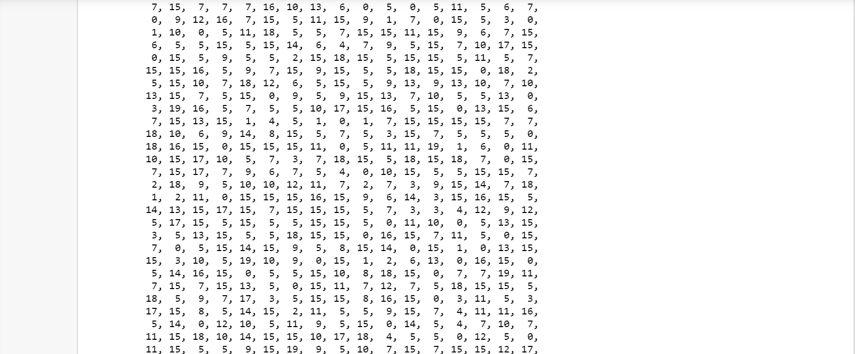

Slide 16
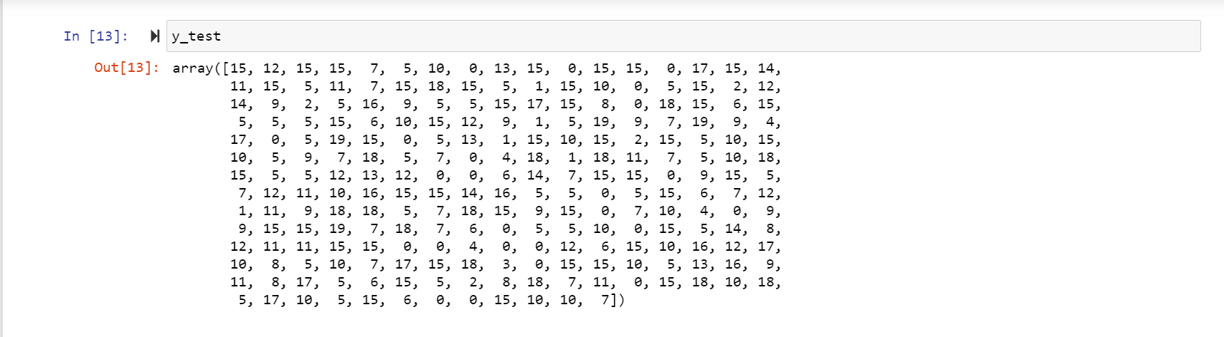

Slide 17
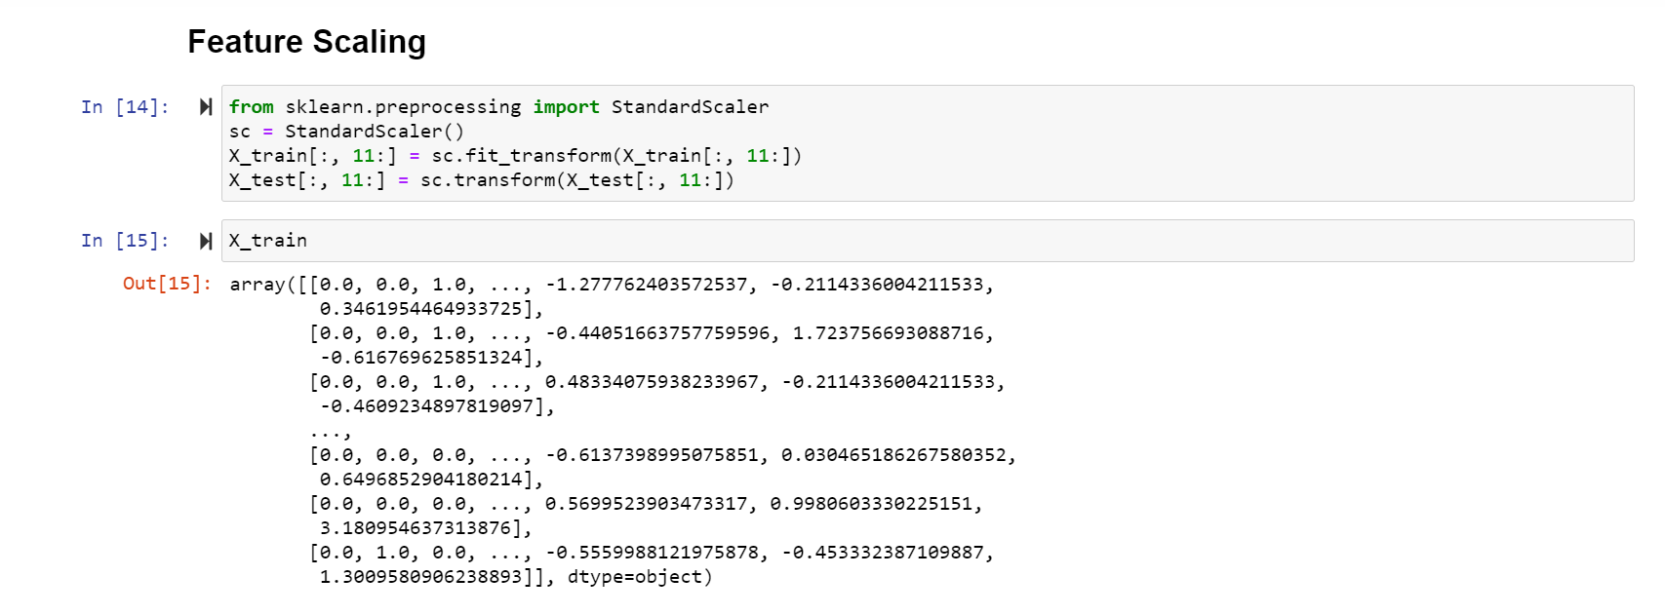
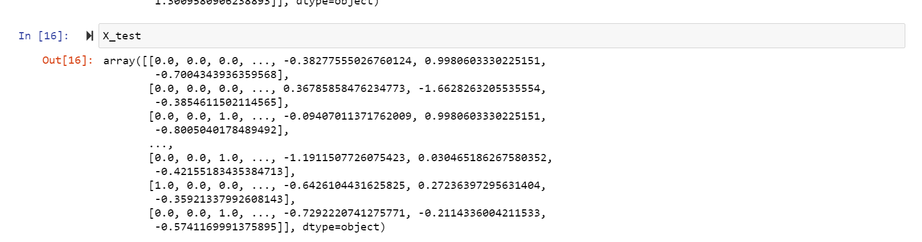

Slide 18
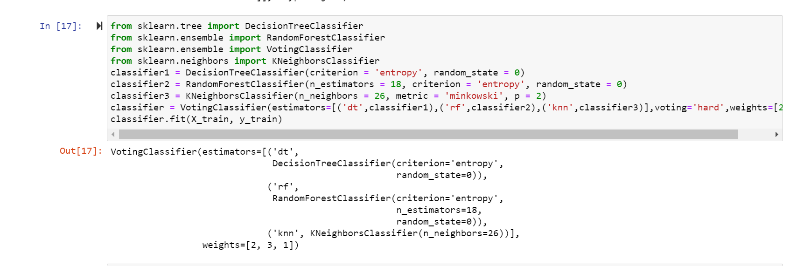
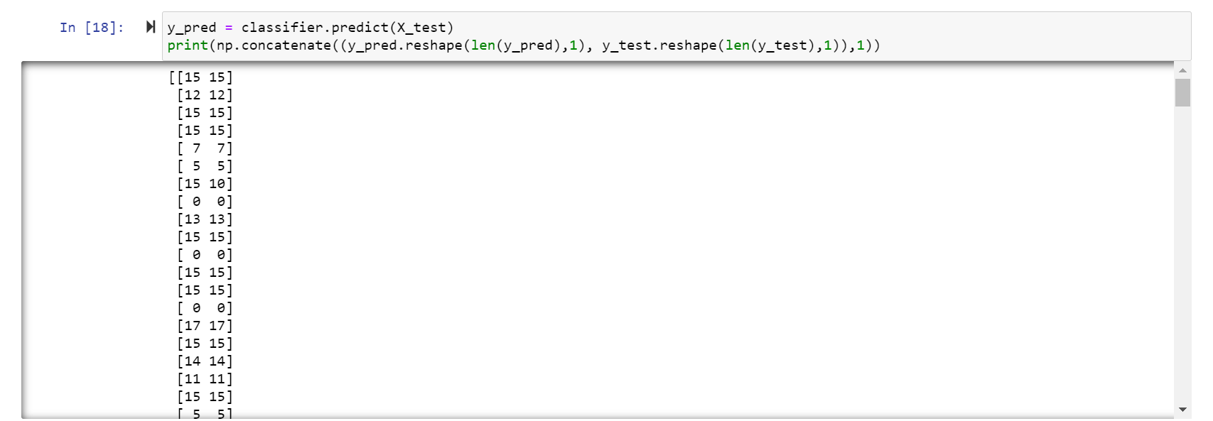

Slide 19
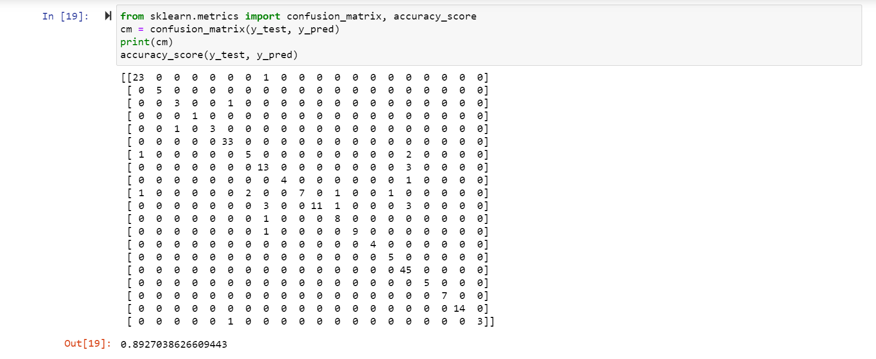

Slide 20
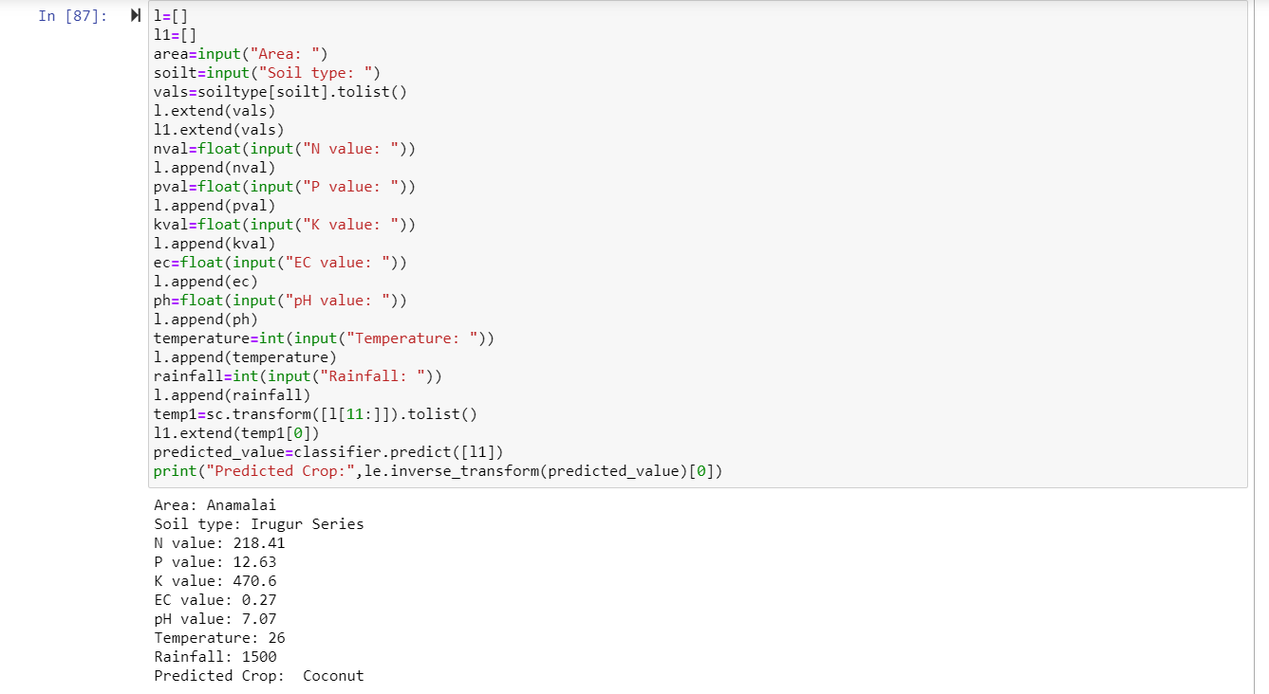

Slide 21
EXISTING SYSTEM
PROPOSED SYSTEM
One existing system used majority voting technique with learners such as Random forest, Decision tree and Naïve Bayes with accuracy 85.4%.
Another existing system used ANN with accuracy 76.1%.
Ensemble model with majority voting technique, using a combination of algorithm namely Random Forest, kNN, and Decision Tree with accuracy 89.27%.

Slide 22
RESULT ANALYSIS

Slide 23
January
Week 1- Week 2
Explore various fields to work on and Topic Selection.
March
Week 3- Week 4
Developing and testing Arduino module for inputting data.
April
Entire System testing and generating Report
January
Week 3 - Week 4
February
Week 1- Week 2
March
Week 1- Week 2
Literary Survey, Finalizing the model and algorithms to be used.
February
Week 3 - Week 4
Studying related concepts, Data Collection, Report
Data Preprocessing, Developing ML Model
Testing accuracy for ML models
PROJECT
TIMELINE
Work done so far
Work to be completed

Slide 24
REFERENCES
Z. Doshi, S. Nadkarni, R. Agrawal and N. Shah, "AgroConsultant: Intelligent Crop Recommendation System Using Machine Learning Algorithms," 2018 Fourth International Conference on Computing Communication Control and Automation (ICCUBEA), Pune, India, 2018, pp. 1-6. doi: 10.1109/ICCUBEA.2018.8697349
S. Pudumalar, E. Ramanujam, R. H. Rajashree, C. Kavya, T. Kiruthika and J. Nisha, "Crop recommendation system for precision agriculture," 2016 Eighth International Conference on Advanced Computing (ICoAC), Chennai, 2017, pp. 32-36. doi: 10.1109/ICoAC.2017.7951740.
Avinash Kumar, Sobhangi Sarkar and Chittaranjan Pradhan, “Recommendation System for Crop Identification and Pest Control Technique in Agriculture”,
International Conference on Communication and Signal Processing, April 4-6, 2019, India.
Tanmay Banavlikar, Aqsa Mahir, Mayuresh Budukh, Soham Dhodapkar, “CROP RECOMMENDATION SYSTEM USING NEURAL NETWORKS”
5. Srilakshmi A, Madhumitha K, Geetha K, “Machine learning approach:Recommendation of suitable crop for land using meteorological factors”

Slide 25
THANK YOU

